Slide 1



PREDICTING GRADUATE ADMISSION USING LINEAR REGRESSION
Hazim Fitri Bin Ahmad Faudzi P152419
Notes:
Assalamualaikum Dr,. My name is Hazim Fitri and my student number is P152419. Today I will be presenting my research on predicting the chance of graduate admissions using linear regression.

Slide 2
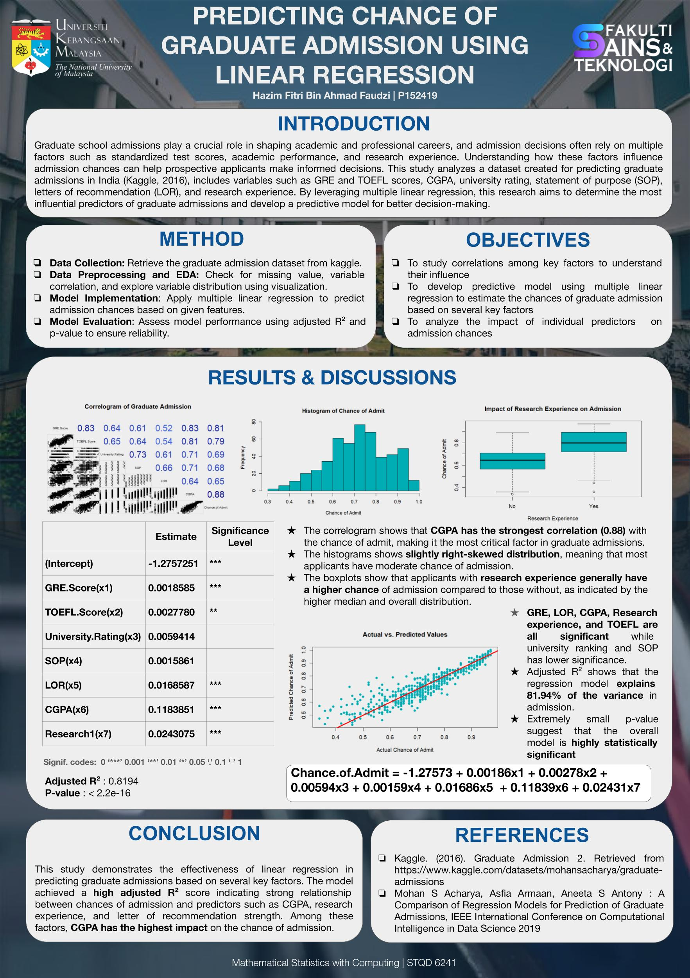

Notes:
"Here’s a brief overview of my research poster. Now, let’s dive straight into the details."

Slide 3

Notes:
Graduate school admissions are a critical step in shaping academic and professional careers. The selection process considers various factors, including standardized test scores, academic performance, and research experience. But how much does each factor truly impact admission chances?
Before diving into the analysis, let me describe a little bit about the dataset used in this study. The dataset, sourced from Kaggle, contains 500 observations and 8 key variables that influence graduate admissions. These variables include standardized test scores such as Graduate Record Examination (GRE) and the Test of English as Foreign Language (TOEFL), academic performance indicators like Cumulative Gred Point Average (CGPA) and university rating, as well as qualitative factors such as statement of purpose (SOP), letters of recommendation (LOR), and research experience. The target variable is the Chance of Admit, which ranges from 0 to 1, representing the probability of an applicant being accepted into a graduate program. Now, let’s move on to the methodology used in this study.

Slide 4

Notes:
To conduct this study, we followed a structured methodology. First, we collected the graduate admission dataset from Kaggle, which contains key variables related to the admission process.
Next, we performed data preprocessing and exploratory data analysis, checking for missing values, analyzing correlations between variables, and visualizing data distributions to understand patterns and trends.
For model implementation, we applied multiple linear regression to predict admission chances based on the given features.
Finally, we evaluated model performance using adjusted R² and p-value to assess reliability and ensure the model accurately explains the variation in admission chances.
This study has three main objectives. First, we aim to examine the correlations among key factors to understand their influence on graduate admission chances.
Second, we seek to develop a predictive model using multiple linear regression to estimate the likelihood of admission based on various important features.
Lastly, we analyze the impact of individual predictors to determine which factors have the most significant effect on admission decisions. These objectives will help provide valuable insights for prospective applicants and academic institutions alike.

Slide 5

Notes:
Now, let's discuss the results.
The correlogram displays the correlation values between our key predictors and the chance of admission. Correlation values range from -1 to 1, where values closer to 1 indicate a strong positive relationship. Now, let's break down the key findings."
CGPA is the strongest predictor of admission. "We can see that CGPA has the highest correlation with the chance of admission, at 0.88. This suggests that academic performance, as reflected in CGPA, plays the most significant role in determining admission chances. In other words, applicants with a higher CGPA have a much stronger likelihood of getting accepted."
GRE and TOEFL scores are also highly correlated with admission chances. "The GRE score has a correlation of 0.81, and the TOEFL score has a correlation of 0.79. This means that standardized test scores are also strong indicators of admission success. High scores in these exams generally translate to better admission prospects."
Letters of Recommendation (LOR) and Statement of Purpose (SOP) have moderate correlations. "The correlation values for LOR and SOP are 0.65 and 0.68, respectively. While these factors do influence admissions, they are not as decisive as CGPA or test scores. This suggests that strong recommendation letters and a well-crafted SOP can improve an applicant’s chances but might not be enough to compensate for weak academic records."
University rating shows a moderate impact. "With a correlation of 0.69, university rating does play a role in admissions, but it is not the most influential factor. While applying to higher-ranked universities may give an applicant some advantage, their academic and test performance remain the primary drivers of admission decisions.
So, what do these findings mean in practical terms?"
"First, the strong correlation of CGPA with admission suggests that students should prioritize maintaining a high GPA, as it has the most significant impact."
"Second, while standardized test scores like GRE and TOEFL matter a lot, they are not the sole determinants. Other factors like research experience, SOP, and LOR still contribute, meaning a well-rounded application is important."
"Lastly, since some independent variables, such as GRE and TOEFL, show high correlation with each other, we should also consider potential multicollinearity issues when interpreting regression results.
Next, The histogram shows a slightly right-skewed distribution, indicating that most applicants have a moderate chance of admission. This skewness suggests potential non-normality, which can impact the assumptions of linear regression.
The next visualization is a boxplot. This boxplot highlights that the research experience increases admission chances, as applicants with research have a higher median and overall distribution of admission probabilities.
“Next, we go to the output after fitting the data into linear regression model. This table displays the estimated coefficients from our multiple linear regression model, along with their significance levels. These coefficients tell us how much each factor contributes to the predicted chance of admission."
1. Intercept:
"First, we have the intercept value of -1.2757. This is the baseline when all predictor variables are zero, though it doesn’t have a direct interpretation in this context."
2. CGPA has the strongest impact on admission chances.
"The coefficient for CGPA is 0.1184, the highest among all predictors. This means that for every one-unit increase in CGPA, the predicted chance of admission increases by 0.118, making it the most influential factor."
3. Research experience is also a key predictor.
"The coefficient for research experience is 0.0243, and it is highly significant (p < 0.001). This suggests that applicants with research experience have a notably higher probability of admission than those without."
4. Letters of Recommendation (LOR) hold significant weight.
"LOR has a coefficient of 0.0166, also with a strong significance level. This confirms that strong recommendation letters can boost an applicant’s chances."
5. GRE and TOEFL scores contribute positively.
"GRE has a coefficient of 0.0019, while TOEFL has a coefficient of 0.0028. Both are positively associated with admission chances, meaning higher scores improve the likelihood of acceptance. However, TOEFL is slightly less significant (p < 0.01), suggesting it has a weaker impact compared to GRE."
6. SOP and University Rating have smaller effects.
"The Statement of Purpose (SOP) has a coefficient of 0.0016, while University Rating has 0.0059. Both are positive, indicating they do contribute to admission chances, but their impact is relatively smaller than other factors."
"From these results, we can draw a few key conclusions:"
"First, CGPA is the most critical factor, reinforcing the importance of maintaining a strong academic record."
"Second, research experience and recommendation letters significantly enhance admission chances, emphasizing the value of extracurricular academic achievements."
"Third, while standardized test scores (GRE & TOEFL) do play a role, their impact is not as strong as CGPA or research experience."
"Finally, SOP and university ranking have relatively minor effects, suggesting that while they are important, they may not be the deciding factors in admission."
The adjusted R² value of 0.8194 indicates that the model explains 81.94% of the variance in admission chances, demonstrating strong predictive power. Additionally, the extremely low p-value confirms that the model is highly statistically significant.
Finally, the actual vs. predicted values plot shows that our regression model performs well, though some variance remains unexplained, potentially due to nonlinear relationships or missing influential factors.

Slide 6

Notes:
In conclusion, this study demonstrates the effectiveness of multiple linear regression in predicting graduate admission chances based on key factors. The model achieved a high adjusted R², indicating a strong relationship between admission probability and predictors like CGPA, research experience, and letters of recommendation.
Among these, CGPA has the most significant impact, reinforcing its importance in the admission process. Overall, this model provides valuable insights for prospective applicants, helping them understand the factors that influence admission decisions and make more informed choices when applying for graduate programs.
Finally, for the references, our study is based on data retrieved from Kaggle (2016), specifically the Graduate Admission dataset. Additionally, we refer to the work by Mohan S. Acharya, Asfia Armaan, and Aneeta S. Antony, which compares various regression models for predicting graduate admissions, published in the IEEE International Conference on Computational Intelligence in Data Science (2019).
These references provide the foundation for our analysis and ensure that our study aligns with established research in graduate admissions prediction.

Slide 7


THE END THANK YOU

